Slide 1
Chapter 17 Java SE 8 Lambdas and Streams

Slide 2
OBJECTIVES
In this chapter you’ll:
Learn various functional-programming techniques and how they complement object-oriented programming.
Use lambdas and streams to simplify tasks that process sequences of elements.
Learn what streams are and how stream pipelines are formed from stream sources, intermediate operations and terminal operations.
Create streams representing ranges of int values and random int values.
Implement functional interfaces with lambdas.
Perform on IntStreams intermediate operations filter, map, mapToObj and sorted, and terminal operations forEach, count, min, max, sum, average and reduce.
Perform on Streams intermediate operations distinct, filter, map, mapToDouble and sorted, and terminal operations collect, forEach, findFirst and reduce.
Process infinite streams.
Implement event handlers with lambdas.

Slide 3
17.1 Introduction
Prior to Java SE 8, Java supported three programming paradigms—procedural programming, object-oriented programming and generic programming.
Java SE 8 added lambdas and streams—key technologies of functional programming.

Slide 4
17.1 Introduction(cont.)
We can use it to write programs faster, simpler, more concisely（简明地）,with fewer bugs, be easier to parallelize than programs written with previous techniques.

Slide 5
17.2 Streams and Reduction
In counter-controlled iteration, we typically accomplish what we want using a for loop.
In this section, we’ll use a better way to accomplish the same tasks.

Slide 6
17.2 Streams and Reduction(cont.)
External Iiteration：
specify all the iteration details
int total = 0;
for (int number = 1; number <= 10; number++) {
total += number;
}
Error Prone
IntStream.rangeClosed(1, 10)
.sum();
A stream is a sequence of elements on which you perform tasks, and the stream pipeline moves the stream’s elements through a sequence of tasks.

Slide 7
IntStream.rangeClosed(1, 10)
create an IntStream containing the ordered sequence of int elements1,2,3,4,5,6,7,8,9 and 10.
IntStream.range(1, 10)
produces an IntStream containing the ordered sequence of int elements 1, 2, 3, 4, 5, 6, 7, 8 and 9, but not 10.

Slide 8
.sum()
returns the sum of all the ints in the stream.
The processing step performed by method sum is known as a reduction—it reduces the stream of values to a single value.

Slide 9

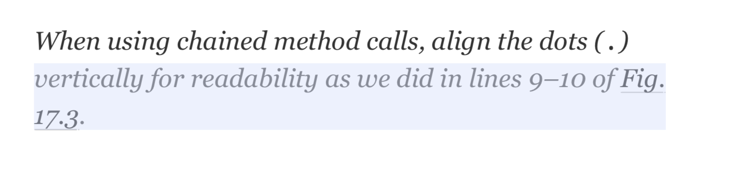

Slide 10
Return a stream with a collection
Interface Collection<E>

Slide 11
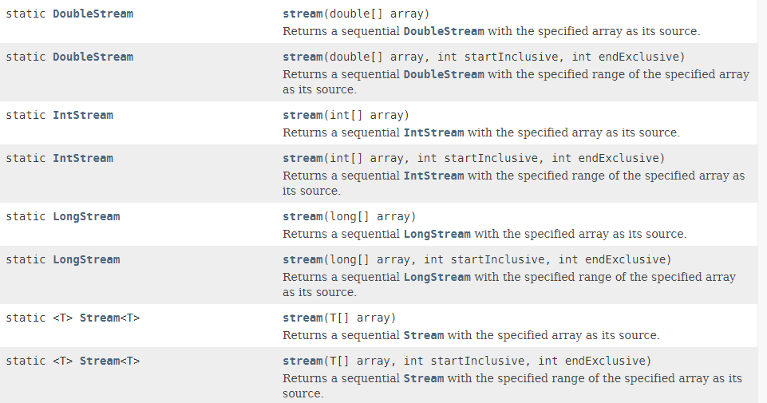
Return a stream with an array Class Arrays

Slide 12
17.2 Streams and Reduction(cont.)
Intermediate operations（中间操作）
use lazy evaluation.
results in a new stream object
map, filter, distinct, limit, sorted
Terminal operation（终止操作、终端操作）
use eager evaluation
initiates a stream pipeline’s processing and produces a result.
count, min, max, average, summaryStatistics，reduce

Slide 13
17.3 Mapping and Lambdas
int total = 0;
for (int number = 2; number <= 20; number += 2) {
total += number;}
IntStream.rangeClosed(1, 10)
.map((int x) -> {return x * 2;})
.sum();

Slide 14
17.3 Mapping and Lambdas(cont.)
lambda expression
represents an anonymous method—a shorthand notation for implementing a functional interface, similar to an anonymous inner class.
The type of a lambda expression is the type of the functional interface that the lambda expression implements.
Lambda expressions can be used anywhere functional interfaces are expected.

Slide 15
17.3 Mapping and Lambdas(cont.)
As of Java SE 8, any interface containing only one abstract method is known as a functional interface（函数式接口）.

Slide 16
Lambda Syntax
A lambda consists of a parameter list followed by the arrow token (->) and a body, as in:
(parameterList) -> {statements}
The following lambda receives two ints and returns their sum:
(int x, int y) -> {return x + y;}

Slide 17
There are several variations of this syntax
the parameter types usually may be omitted, as in:
(x, y) -> {return x + y;}
When the body contains only one expression, the return keyword and curly braces may be omitted, as in:
(x, y) -> x + y
When the parameter list contains only one parameter, the parentheses may be omitted, as in:
value -> System.out.printf("%d ", value)
x -> x * 2
To define a lambda with an empty parameter list：
() -> System.out.println("Welcome to lambdas!")

Slide 18
17.4 Filtering
int total = 0;
for (int x = 1; x <= 10; x++) {
if (x % 2 == 0) { // if x is even
total += x * 3;
}
}
IntStream.rangeClosed(1, 10)
.filter(x -> x % 2 == 0)
.map(x -> x * 3)
.sum();

Slide 19
17.5 How Elements Move Through Stream Pipelines
the stream pipeline operates as follows:
IntStream.rangeClosed(1, 10)
.filter(x -> x % 2 == 0)
.map(x -> x * 3)
.sum();
For each element
If the element is an even integer
Multiply the element by 3 and add the result to the total

Slide 20
17.5 How Elements Move Through Stream Pipelines(cont.)
When you initiate a stream pipeline with a terminal operation, the intermediate operations’ processing steps are applied for a given stream element before they are applied to the next stream element.

Slide 21
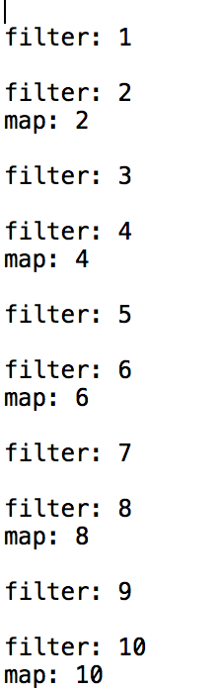
IntStream.rangeClosed(1, 10).filter(
x -> {
System.out.printf("%nfilter: %d%n", x);
return x % 2 == 0;
})
.map(
x -> {
System.out.println("map: " + x);
return x * 3;
})
.sum();

Slide 22
17.6 Method References
For a lambda that simply calls another method, you can replace the lambda with that method’s name—known as a method reference.

Slide 23
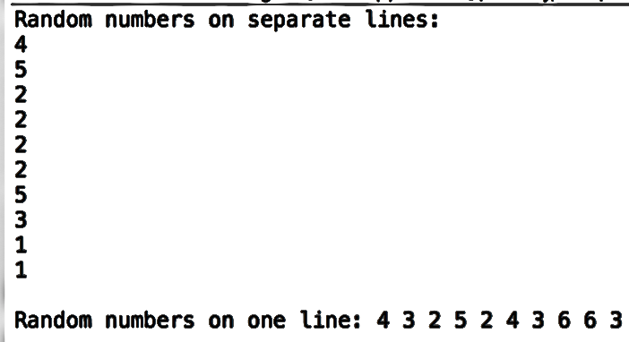
randomNumbers.ints(10, 1, 7)
.forEach(System.out::println);
// display 10 random integers on the same line
String numbers =
randomNumbers.ints(10, 1, 7)
.mapToObj(String::valueOf)
.collect(Collectors.joining(" "));
System.out.printf("%nRandom numbers on one line: %s%n", numbers);

Slide 24
17.6 Method Referennces (cont.)
IntStream method mapToObj enables you to map from ints to a stream of reference-type elements.
The Stream terminal operation collect uses a collector to gather the stream’s elements into a single object—often a collection.
static Collectors method joining creates a concatenated String representation of the stream’s elements.

Slide 25
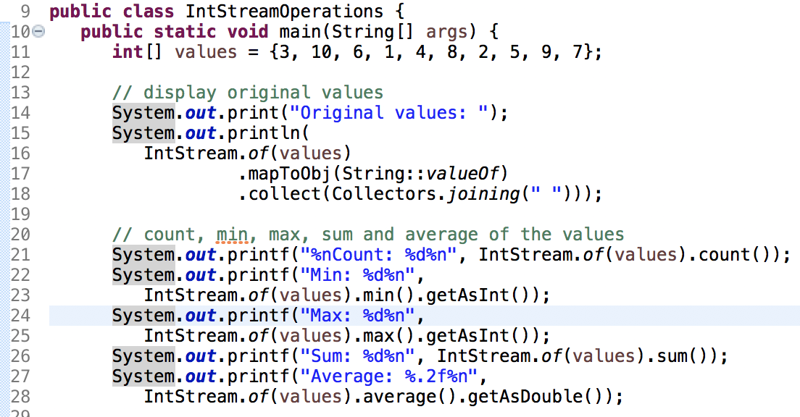
17.7 IntStream Operation

Slide 26
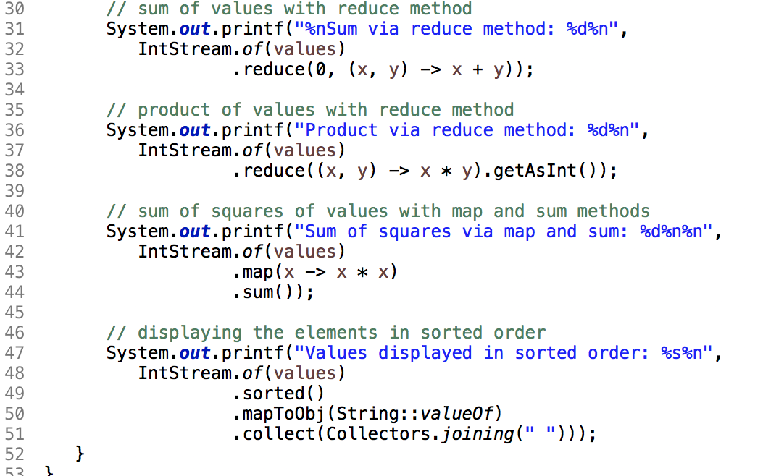

Slide 27
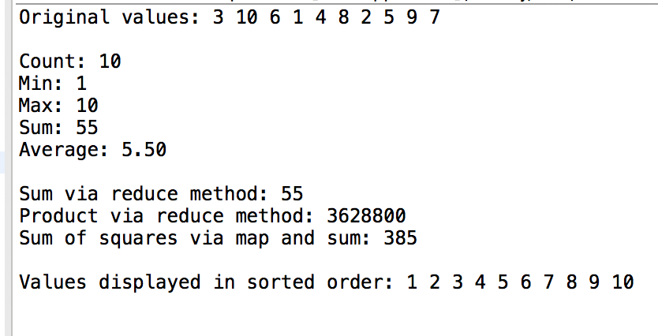

Slide 28
IntStream.of(values)
creates an IntStream from the array values
System.out.println(IntStream.of(values).summaryStatistics());
Produces:
IntSummaryStatistics{count=10, sum=55, min=1, average=5.500000, max=10}

Slide 29
IntStream.of(values)
.reduce(0, (x, y) -> x + y)
The first argument to reduce(0) is the operation’s identity value.
The second argument is a method that receives two int values (representing the left and right operands of a binary operator), performs a calculation with the values and returns the result.

Slide 30
17.8 Functional Interfaces
functional interface
an interface that contains exactly one abstract method (and may also contain default and static methods)

Slide 31
referential transparency（RT, 引用透明性）
An expression is referentially transparent if it can be replaced by its resulting value without changing the behavior of the program. This must be true regardless of where the expression is used in the program.
Notes:
即如果提供同样的输入，那么函数总是返回同样的结果。就是说，表达式的值不依赖于可以改变值的全局状态。

Slide 32
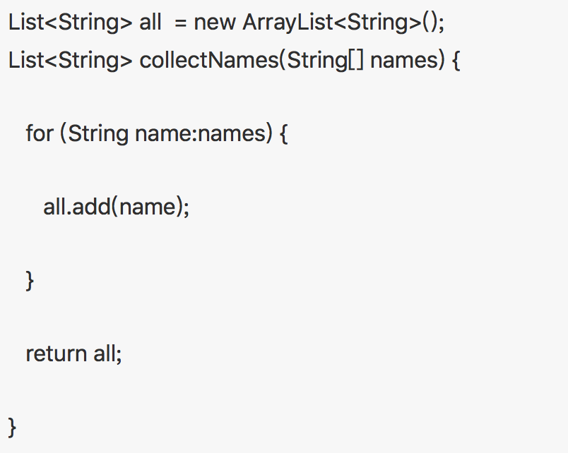
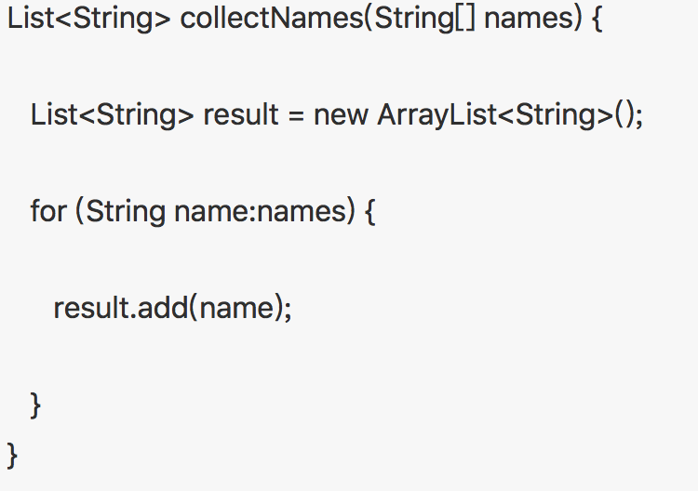
referential transparency？
✅
❎

Slide 33
17.8 Functional Interfaces(cont.)
Pure functions
depend only on their parameters
have no side-effects and do not maintain any state.
In Java, pure functions are methods that implement functional interfaces—typically defined as lambdas
Notes:
Pure functions
纯函数

Slide 34
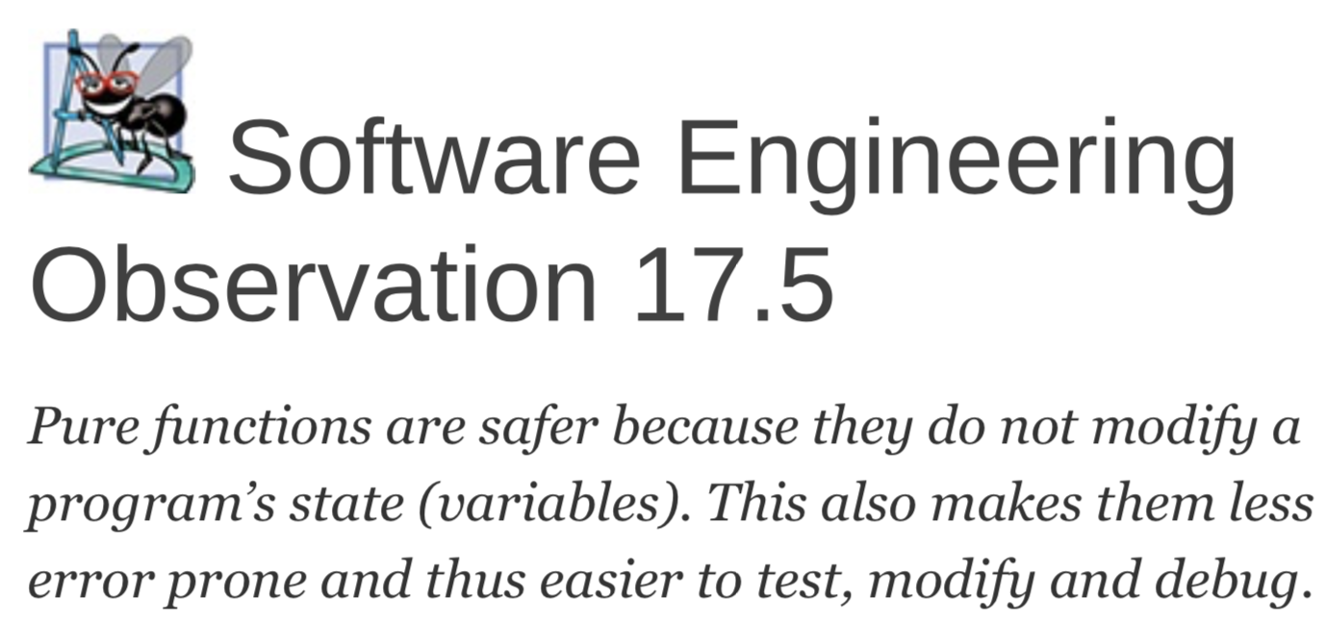

Slide 35
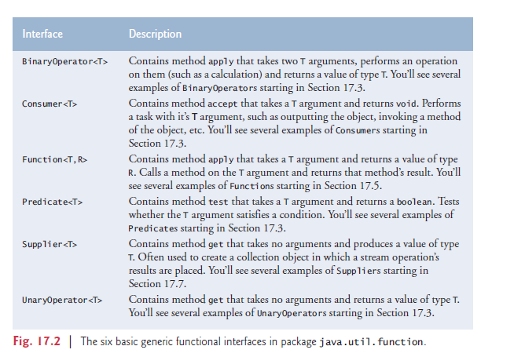
The six basic generic functional interfaces in package java.util.function.

Slide 36
17.9 Lambdas: A Deeper Look
Lambda expressions can be used anywhere functional interfaces are expected.

Slide 37
IntStream.rangeClosed(1, 10)
.filter(x -> x % 2 == 0)
.map(x -> x * 3)
.sum()
IntStream filter​(IntPredicate predicate)
boolean test(int value)
x
x % 2 == 0

Slide 38
IntStream.rangeClosed(1, 10)
.filter(x -> x % 2 == 0)
.map(x -> x * 3)
.sum()
IntStream map​(IntUnaryOperator mapper)
int applyAsInt​(int operand)
x
x * 3
Notes:
the target type is IntUnaryOperator, which represents a method that takes one int parameter and returns an int result. In this case, the lambda parameter’s type is explicitly declared to be int and the compiler infers the lambda’s return type as int, because that’s what an IntUnaryOperator requires.

Slide 39
17.9 Lambdas: A Deeper Look(cont.)
Scope and Lambdas
lambdas do not have their own scope
Capturing Lambdas and final Local Variables
A lambda that refers to a local variable from the enclosing method (known as the lambda’s lexical scope语法范围) is a capturing lambda.
Any local variable that a lambda references in its lexical scope must be final.

Slide 40
17.10 Stream<Integer> Manipulations
IntStream is simply an int-optimized Stream that provides methods for common int operations.

Slide 41
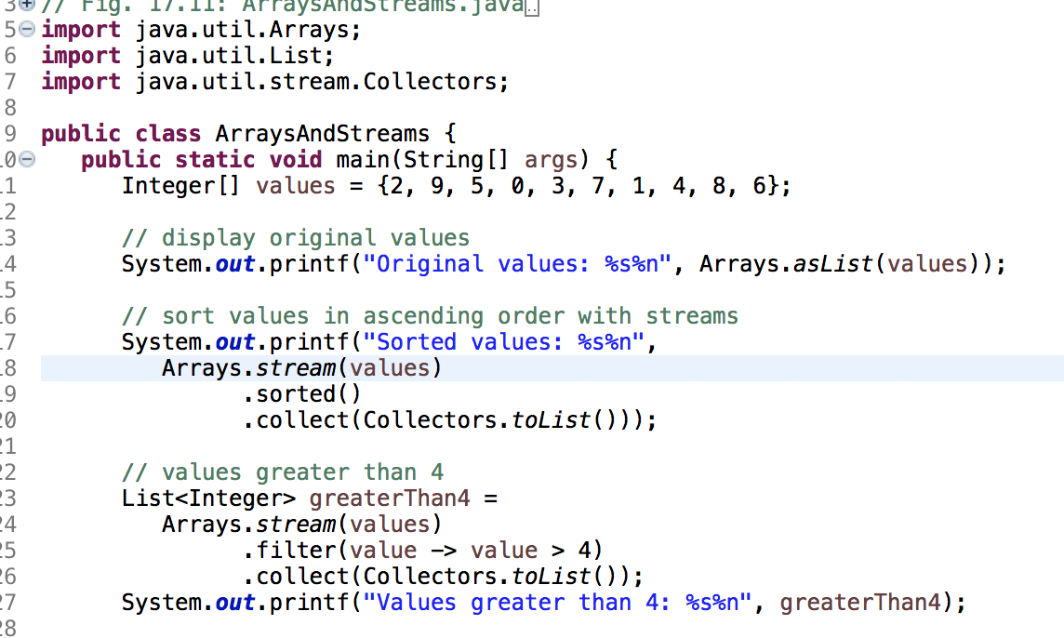

Slide 42
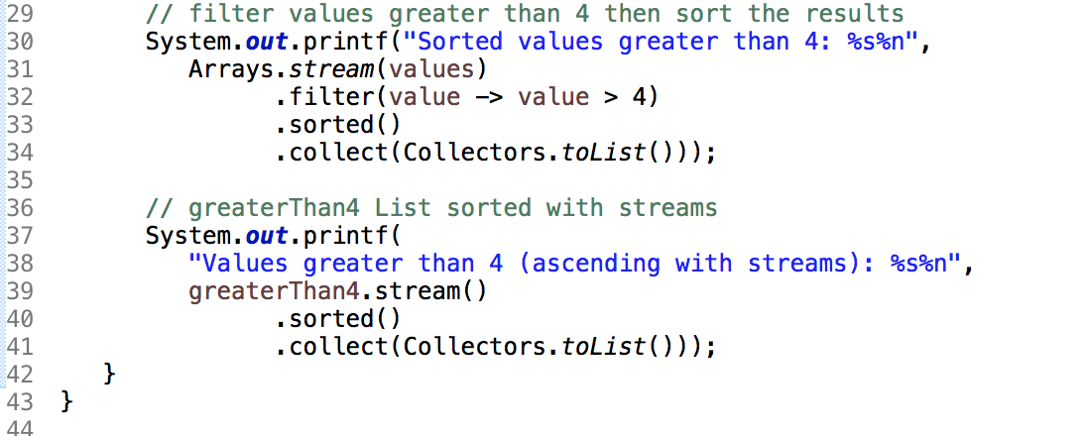
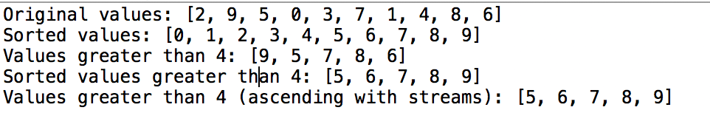

Slide 43
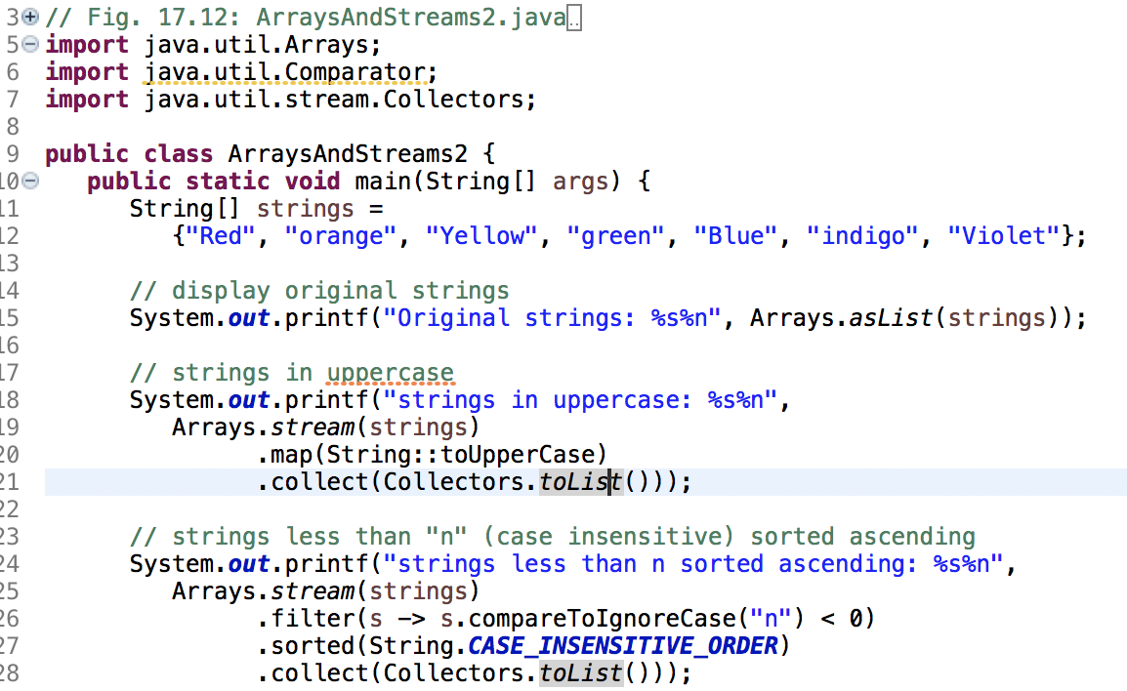
17.11 Stream<String> Manipulations

Slide 44
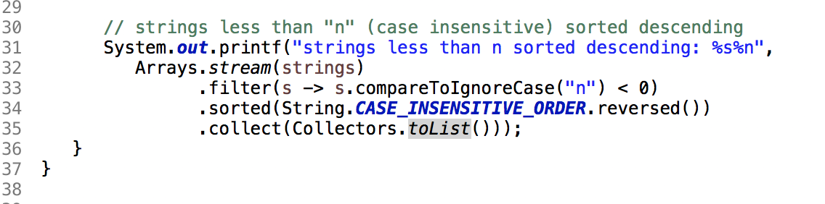
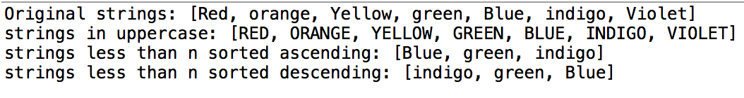

Slide 45
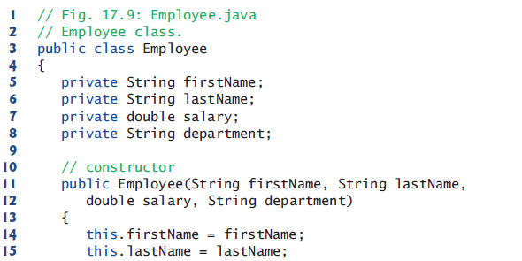
17.12 Stream<Employee> Manipulations
Example:
Fig17_31_21

Slide 46
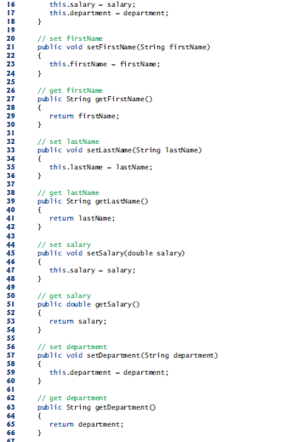

Slide 47
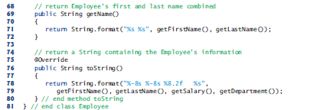

Slide 48
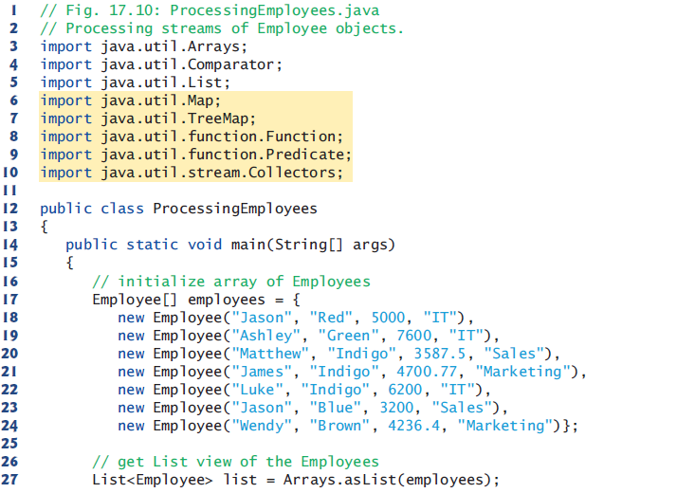

Slide 49
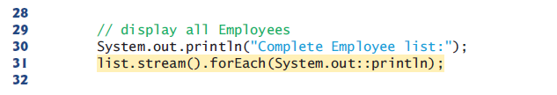
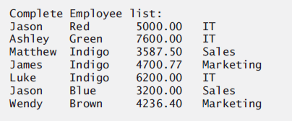

Slide 50
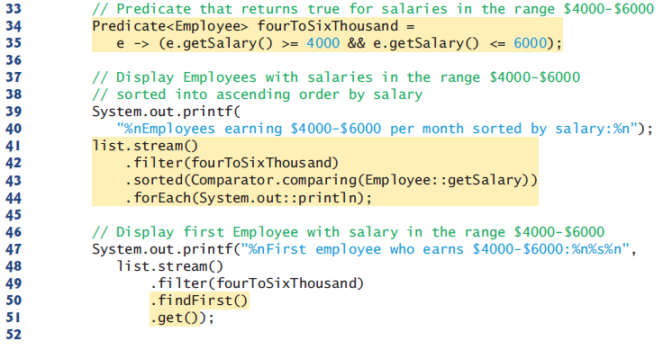
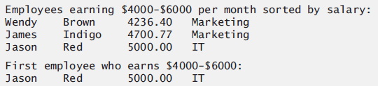
Filtering Employees with Salaries in a Specified Range

Slide 51
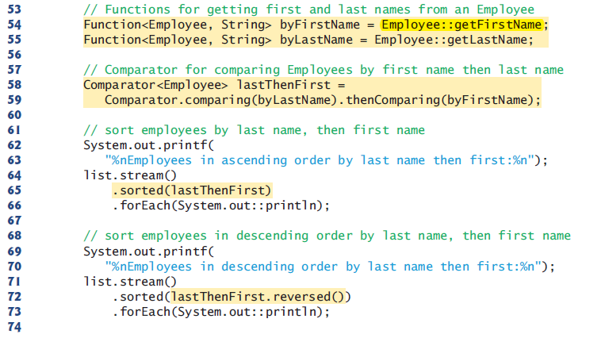
Sorting Employees By Multiple Fields

Slide 52
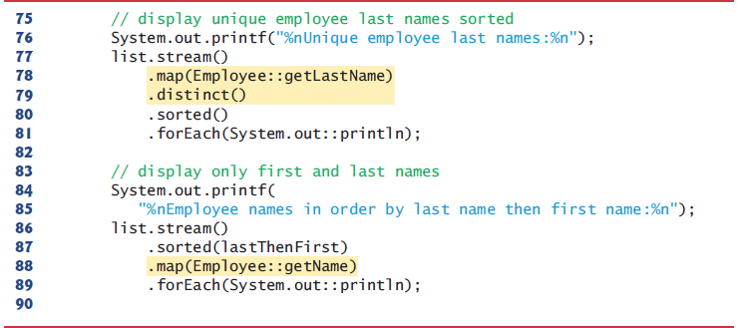
Mapping Employees to Unique Last Name Strings

Slide 53
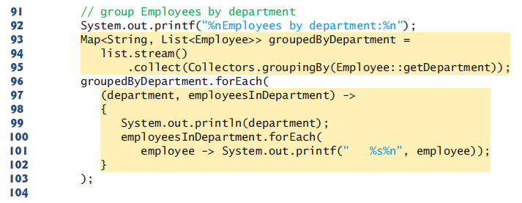
Grouping Employees By Department
we use the Collector returned by Collectors static method
groupingBy, which receives a Function that classifies the objects in the stream—the values returned by this function are used as the keys in a Map.

Slide 54
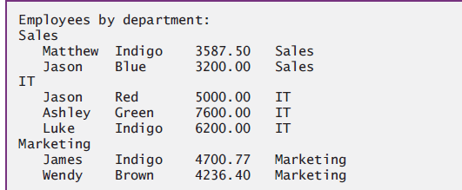

Slide 55
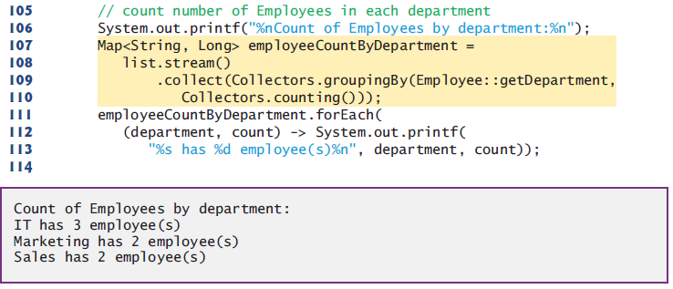
Counting the Number of Employees in Each Department
we use a version of Collectors static method groupingBy that receives two arguments—the first is a Function that classifies the objects in the stream and the second is another Collector (known as the downstream Collector).

Slide 56
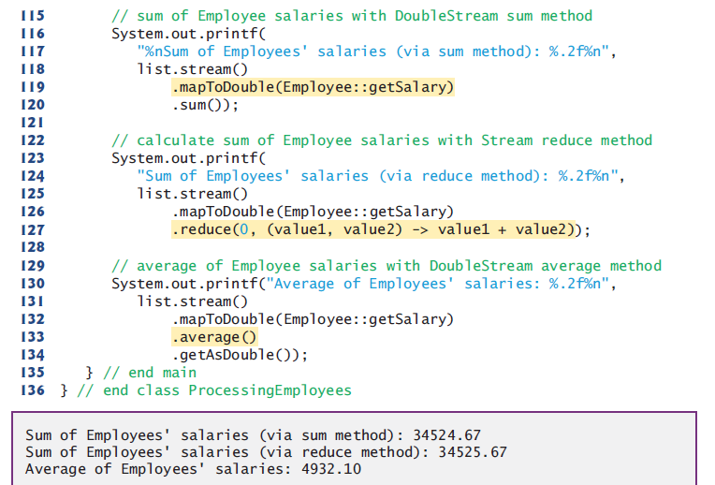
Summing and Averaging Employee Salaries

Slide 57
17.12 Stream<Employee> Manipulations(cont.)
Java SE 9: Creating an Immutable List<Employee> with List Method of
List<Employee> list = List.of(
new Employee("Jason", "Red", 5000, "IT"),
new Employee("Ashley", "Green", 7600, "IT"),
new Employee("Matthew", "Indigo", 3587.5, "Sales"),
new Employee("James", "Indigo", 4700.77, "Marketing"),
new Employee("Luke", "Indigo", 6200, "IT"),
new Employee("Jason", "Blue", 3200, "Sales"),
new Employee("Wendy", "Brown", 4236.4, "Marketing"));

Slide 58
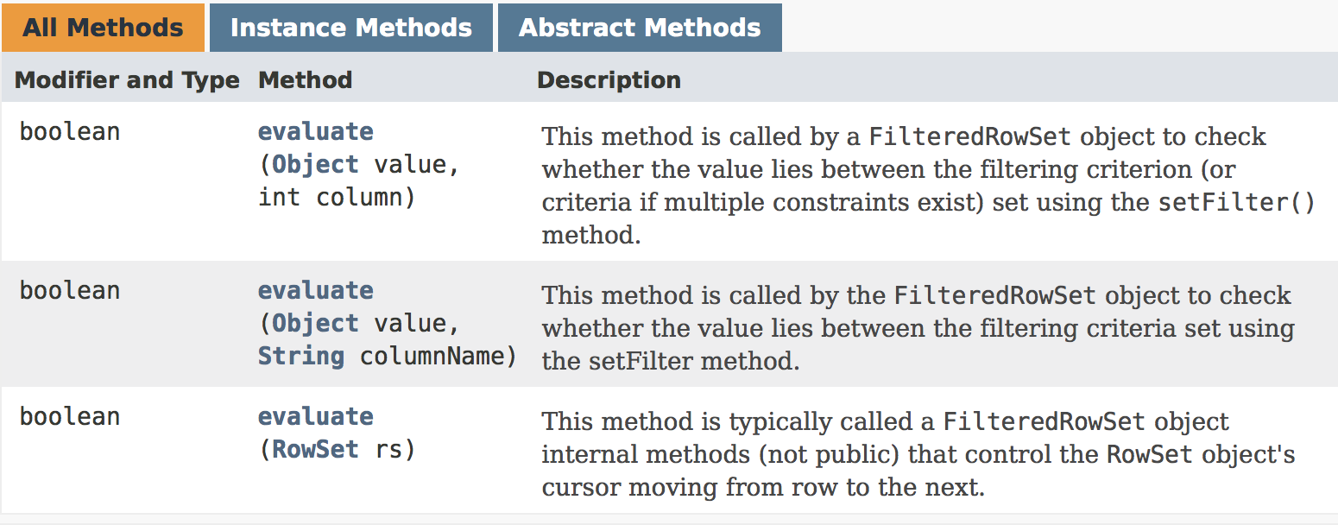
17.12 Stream<Employee> Manipulations(cont.)
Predicate<Employee>

Slide 59
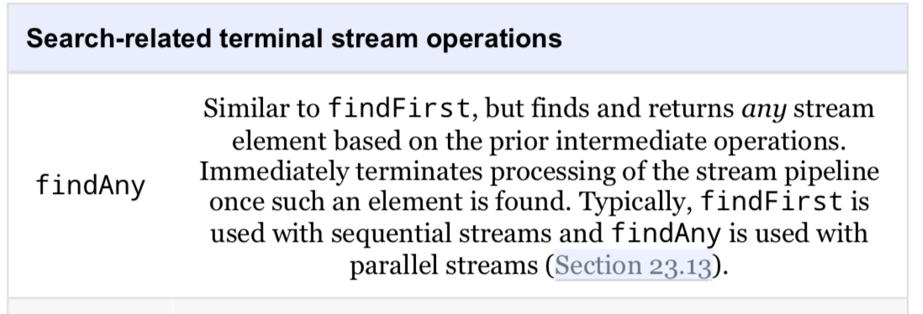
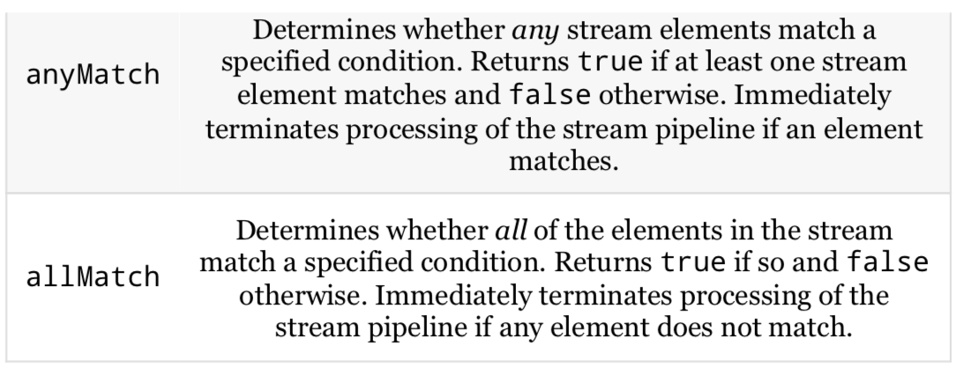

Slide 60
17.12 Stream<Employee> Manipulations(cont.)
Aside: Composing Lambda Expressions
Many functional interfaces in the package java.util.function package provide default methods that enable you to compose functionality.
For example, the interface IntPredicat contains three default methods: and,negate,or.

Slide 61
IntPredicate even = value -> value % 2 == 0;
IntPredicate greaterThan5 = value -> value > 5;
even.and(greaterThan5);

Slide 62
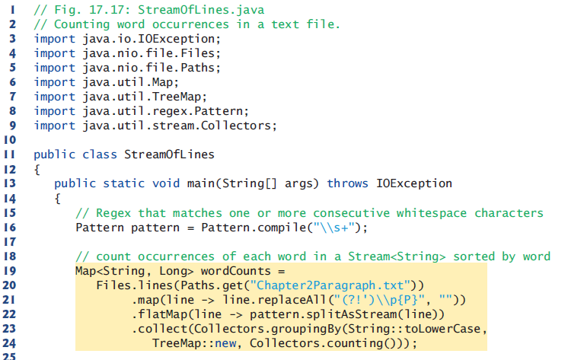
17.13 Creating a Stream<String> from a File
Notes:
\p{P}标点符号

Slide 63
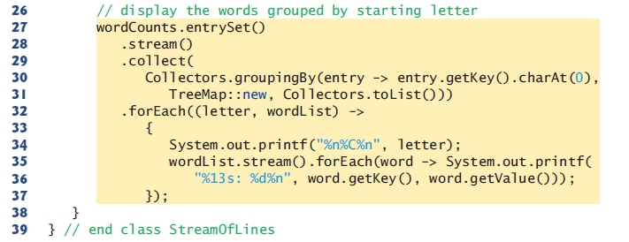
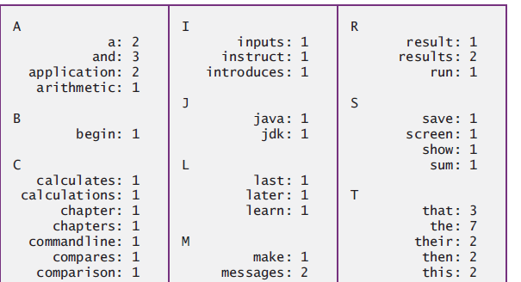

Slide 64
Line 20 uses Files method lines to create a Stream<String> for reading the lines of text from a file
Line 22 uses Stream method flatMap to break each line of text into its separate words.
The lambda in line 22 passes the String representing a line of text to Pattern method split- AsStream (new in Java SE 8), which uses the regular expression specified in the Pattern (line 16) to tokenize the String into its individual words.
Reference： http://thihy.iteye.com/blog/1777065

Slide 65
Collectors method groupingBy that receives three arguments— a classifier, a Map factory and a downstream Collector.
The classifier is a Function that returns objects for use as keys in the resulting Map—the method reference String::toLowerCase converts each word in the Stream<String> to lowercase. The Map factory is an object that implements interface Supplier and returns a new Map collection

Slide 66
So, line 27 calls Map method entrySet on wordCounts to get a Set of Map.Entry objects that each contain one key–value pair from wordCounts. This produces an object of type Set<Map.Entry<String, Long>>.
Line 28 calls Set method stream to get a Stream<Map.Entry<String, Long>>.

Slide 67
Lines 29–31 call Stream method collect with three arguments—a classifier, a Map factory and a downstream Collector. The classifier Function in this case gets the key from the Map.Entry then uses String method charAt to get the key’s first character—this becomes a Character key in the resulting Map. Once again, we use the constructor reference TreeMap::new as the Map factory to create a TreeMap that maintains its keys in sorted order. The downstream Collector (Collectors.toList()) places the Map.Entry objects into a List collection.

Slide 68
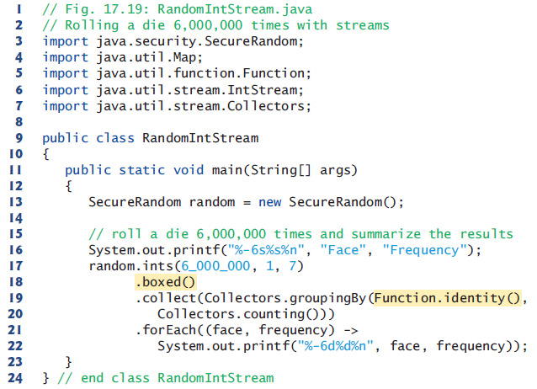
17.14 Streams of Random Values

Slide 69
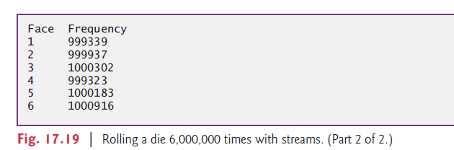

Slide 70
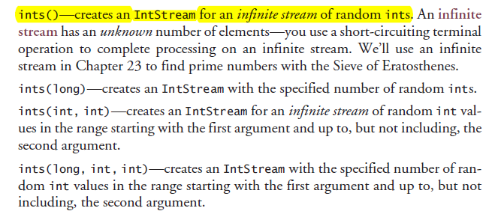

Slide 71
Converting an IntStream to a Stream<Integer>
We do this by calling IntStream method boxed.

Slide 72
Static method identity from interface Function creates a Function that simply returns its argument.

Slide 73
17.15 Infinite Streams
Lazy evaluation makes it possible to work with infinite streams that represent an unknown, potentially infinite, number of elements.

Slide 74
IntStream method iterate generates an ordered sequence of values starting with the seed value (1) in its first argument.
IntStream.iterate(1, x -> x + 1)
.forEach(System.out::println);
We did not specify how many elements to produce, so this is the equivalent of an infinite loop.
IntStream.iterate(1, x -> x + 1)
.limit(10)
.forEach(System.out::println);
limits the total number of elements produced to 10, so it displays the numbers from 1 through 10.

Slide 75
IntStream method generate create unordered infinite streams.
IntStream.generate(() -> random.nextInt())
.limit(10)
.forEach(System.out::println);
This is equivalent to using SecureRandom’s no- argument ints method
SecureRandom.ints()
.limit(10)
.forEach(System.out::println);

Slide 76
17.16 Lambda Event Handlers
tipPercentageSlider.valueProperty().addListener(
new ChangeListener<Number>() {
@Override
public void changed(ObservableValue<? extends Number> ov,
Number oldValue, Number newValue) {
tipPercentage =
BigDecimal.valueOf(newValue.intValue() / 100.0);
tipPercentageLabel.setText(percent.format(tipPercentage));
}
}
);

Slide 77
can be implemented more concisely with a lambda as:
tipPercentageSlider.valueProperty().addListener(
(ov, oldValue, newValue) -> {
tipPercentage =
BigDecimal.valueOf(newValue.intValue() / 100.0);
tipPercentageLabel.setText(percent.format(tipPercentage));
});

Slide 78
17.17 Additional Notes on Java SE 8 Interfaces
Java SE 8 Interfaces Allow Inheritance of Method Implementations
When a class implements an interface with default methods and does not override them, the class inherits the default methods’ implementations.
If a class implements two or more unrelated interfaces that provide a default method with the same signature, the implementing class must override that method; otherwise, a compilation error occurs.

Slide 79
17.17 Additional Notes on Java SE 8 Interfaces(cont.)
An interface’s designer can now evolve an interface by adding new default and static methods without breaking existing code that implements the interface.

Slide 80
17.17 Additional Notes on Java SE 8 Interfaces(cont.)
Java SE 8: @FunctionalInterface Annotation
you can declare that an interface is a functional interface by preceding it with the @FunctionalInterface annotation.
The compiler will then ensure that the interface contains only one abstract method; otherwise, it will generate a compilation error.

